Slide 1
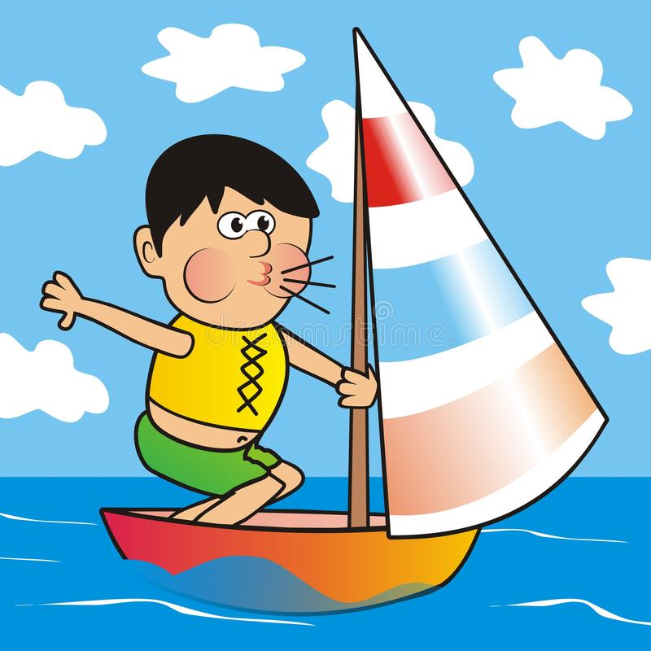
“On What Follows” – an exploration of a “happy idea”, with a few tangents
(Sort of L.P. & S.P. combined)

Slide 2
On what is to follow:
A sequence of steps, each a self-contained idea – yet the combination is a
bit mind-boggling.
I’ll do my best to convince you of the soundness of each step, feel free to
ask questions. If I can’t answer them all, please be aware that this is true
as far as we know. (There is basically no math here, which may make
specific answers harder to provide. But intuition should be enough.)
3. There is one main line of argument, but I will need a few simple digressions to make some
key points.

Slide 3
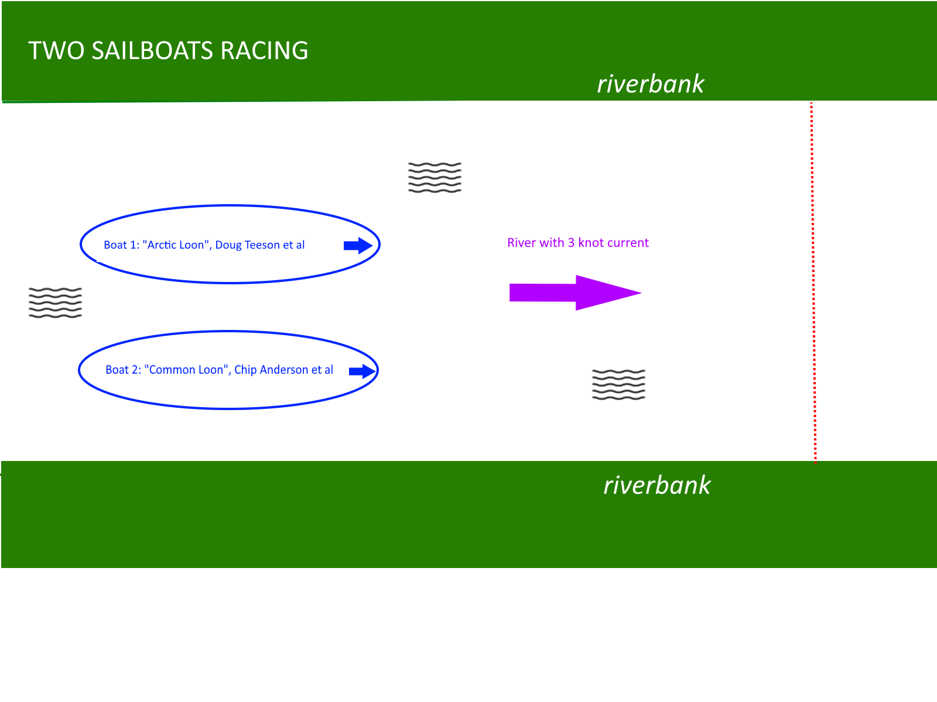
(or thinking about it)
Both boats have sails furled.
Then fog descends, the riverbanks are no longer visible….

Slide 4
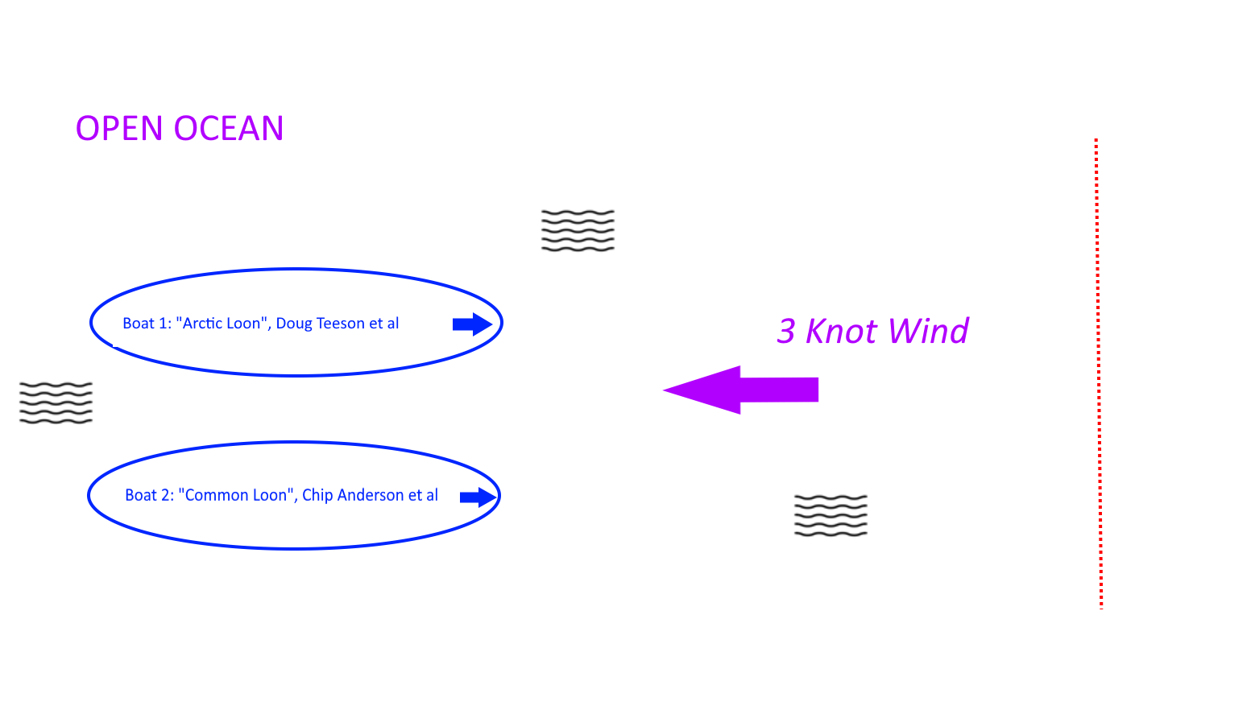
Now who wins?

Slide 5
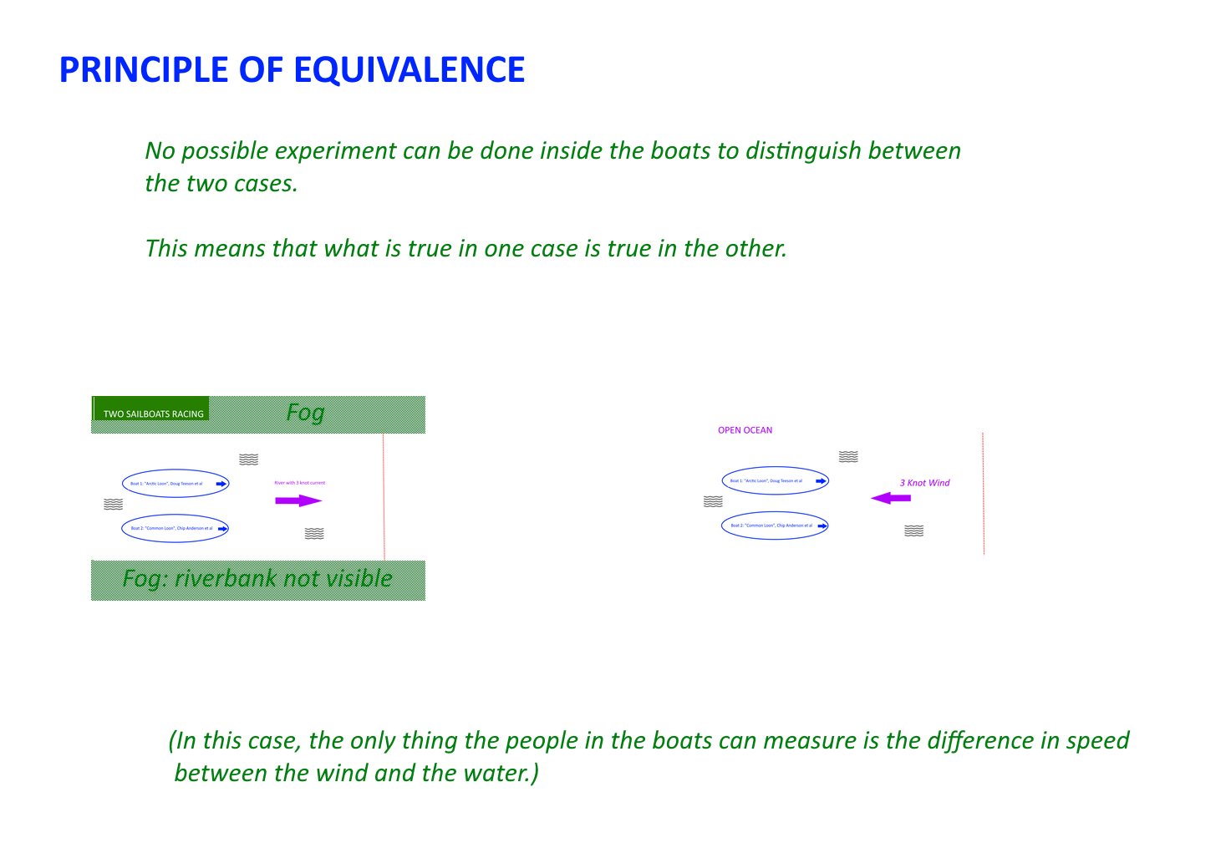

Slide 6
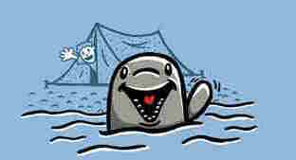

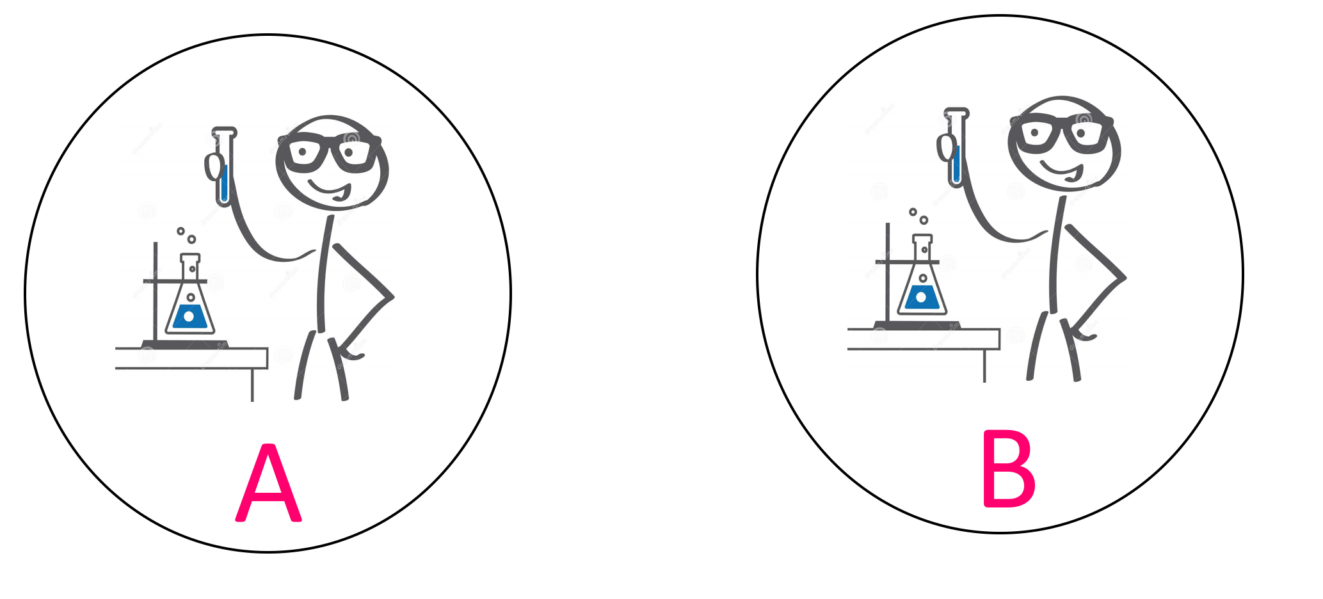
Seems like a ‘truism’ – if no possible experiment can find any difference,
the physics in both cases has to be the same.

Slide 7
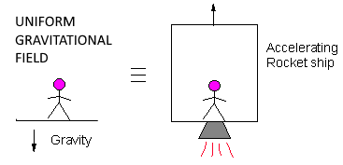
A part-time Watch Hill resident had what he called one of his ‘happiest thoughts’ when he thought of another Principle of Equivalence:
For now, let’s just stipulate that this is true, and see where it leads.

Slide 8
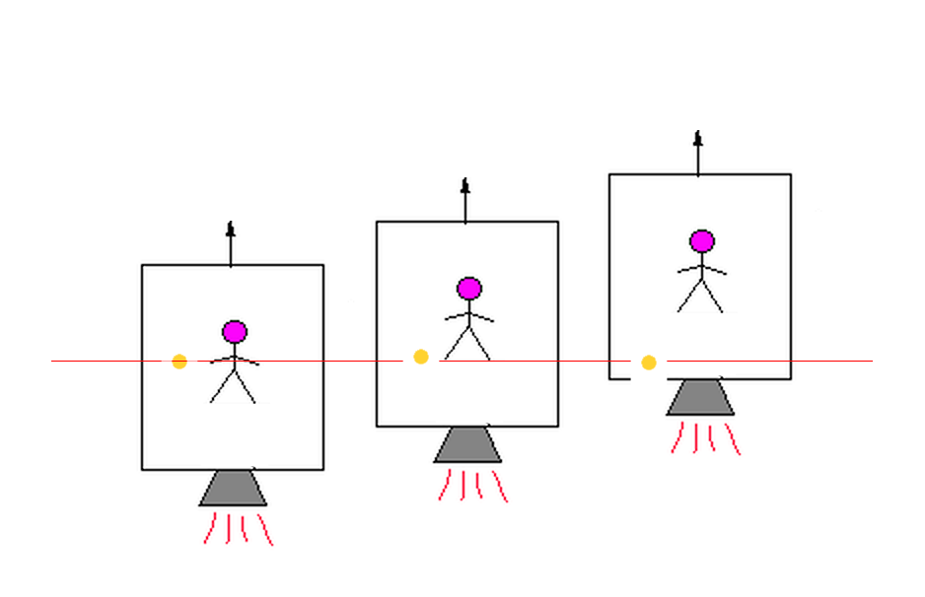
PRINCIPLE OF EQUIVALENCE IMPLICATION 1
Acceleration of elevator up
makes inertial object seem to
Accelerate down

Slide 9
Principle of Equivalence restatement: there is no possible
experiment you can do to detect
any difference between these two conditions.

Slide 10
Serious physics question 1 that you can now answer:
Light (as photons or waves) has no mass.
Newton’s law of gravitation says gravity is only an
attraction between masses.
Does gravity bend light, or not?

Slide 11
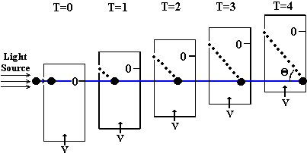
Serious physics question 1 that you can now answer:
Light (as photons or waves) has no mass. Newton’s law of gravitation says gravity only is an attraction
between masses.
Does gravity bend light, or not?
Light, like the tennis ball, will to the observer in
the elevator seem to drop (the dotted line) – to him,
he will see his apparent gravity bend the light.
(But by the principle of equivalence, he just sees
gravity bend light. And it does.)

Slide 12
Serious physics question 2 that you can now answer:
Why do masses of different size and weight fall at the same rate?

Slide 13
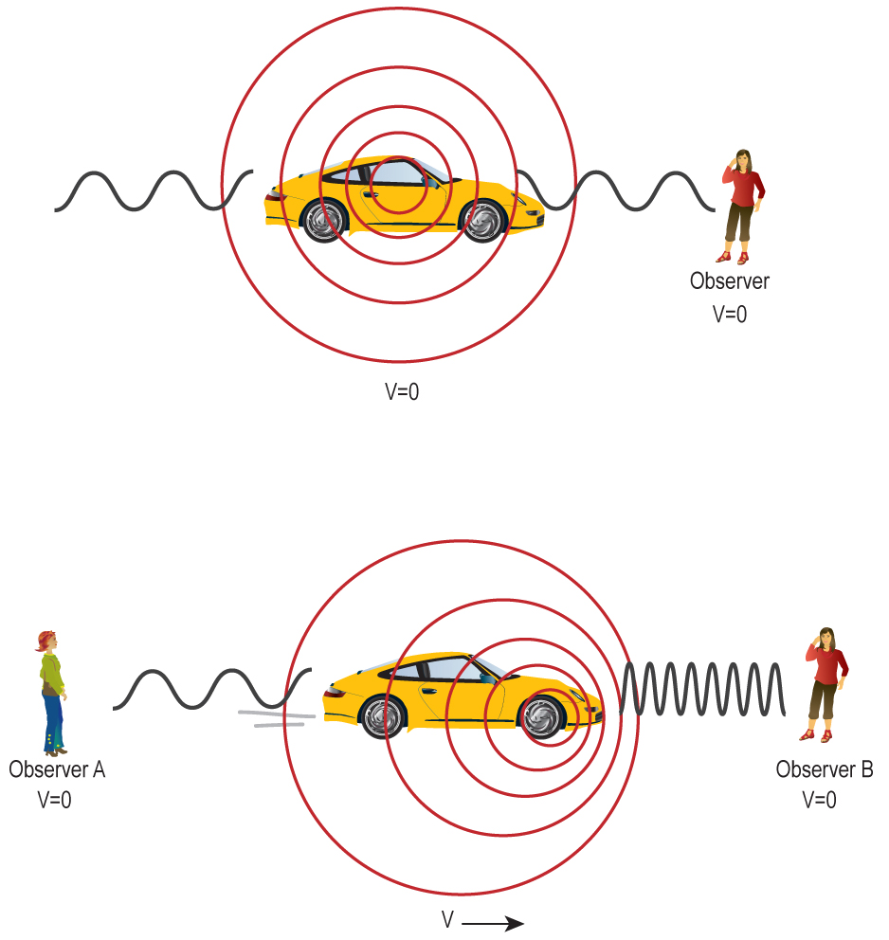

Minor digression one: The Doppler Effect
(Clock ticks)

Slide 14
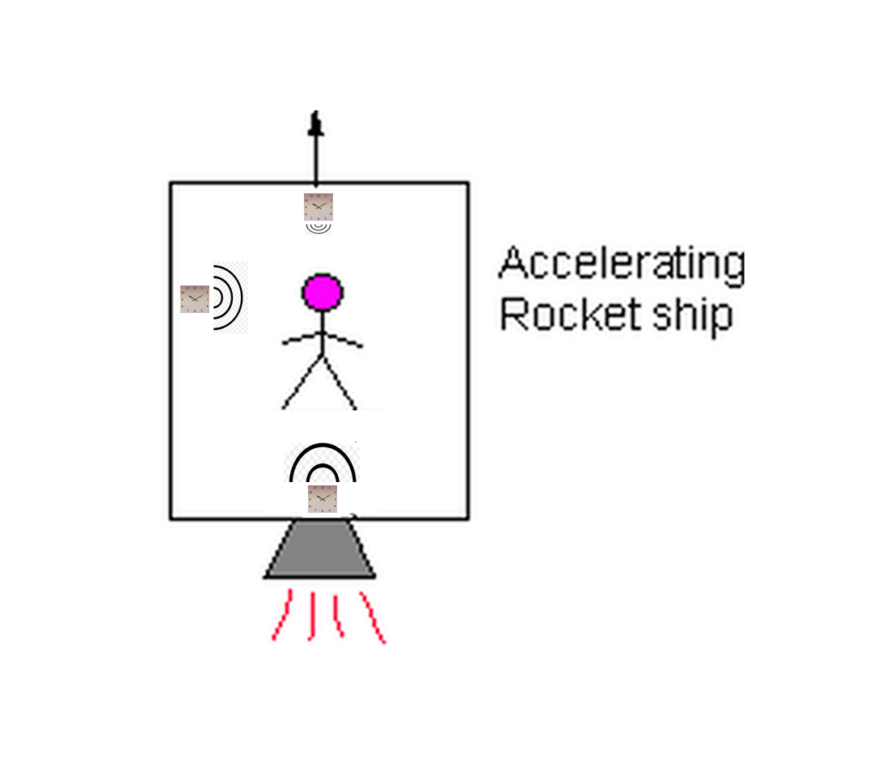

Slide 15

Time Weirdness in Gravitational
Fields
Doppler rates of clock mean that clocks above the observer
seem to run faster, clocks below run slower, and ones at the
same level run at the same rate.
(free space clock)
This is not merely an ‘illusion’, the observer in the elevator/gravitational field sees this as verifiable reality.

Slide 16
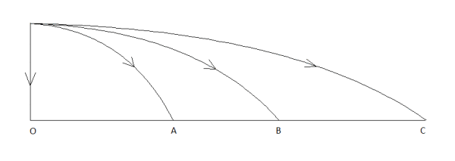
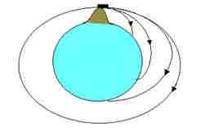
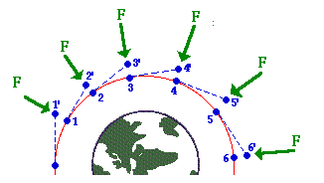
Another Brief Digression: Orbits
Free falling in gravity is equivalent to no gravity.
(Go back to elevator – if no acceleration measureable inside elevator, guy inside floats, no apparent gravity, even if entire elevator is ‘falling’ to an outside observer)
Principle of Equivalence again.

Slide 17
A Brief Pause – A Riddle
(if you know the answer to this please let others work it out.)
A hunter leaves his tent, walks one mile south, one mile east
– shoots a bear – then one mile north
and arrives back at his tent.
WHAT COLOR WAS THE BEAR?

Slide 18
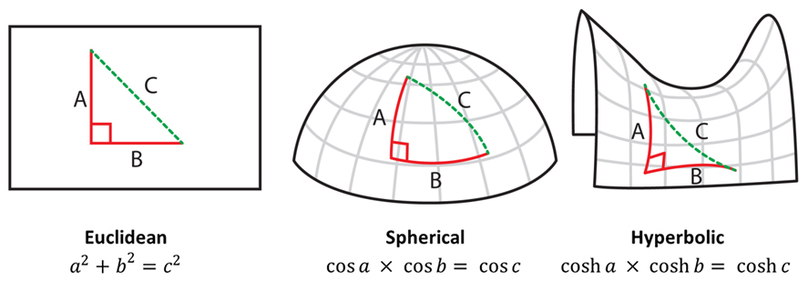
A little bit on non-flat surfaces and shapes:

Slide 19
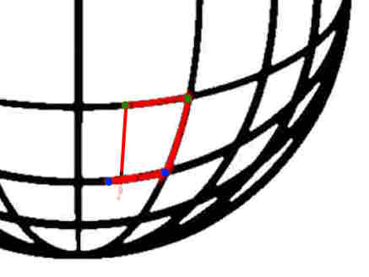
Trying to draw a rectangle with equal sides on a spherical surface:
- the distance between the green dots is the same as the distance as between the blue dots;
- the verticals follow geodesics (“great circle routes”)
- the lines don’t meet, the line coming down in the middle hits the lower horizontal
Similarly, going 100 miles east at
the equator changes your longitude
but a little, while if you do it near the
North Pole, you can change it a lot.

Slide 20
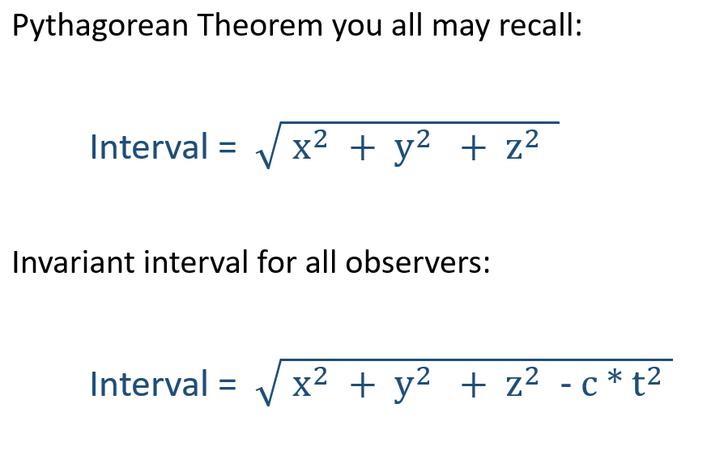
A Little Weirdness, Shortly to be Demonstrated by Heathcliff & I
Physicists refer to the odd mix of space and time as “spacetime”.
Different observers watching events may see them at different times and distances in their own
reference frames;
All observers agree on a spacetime distance measure, no matter what they’re doing:

Slide 21
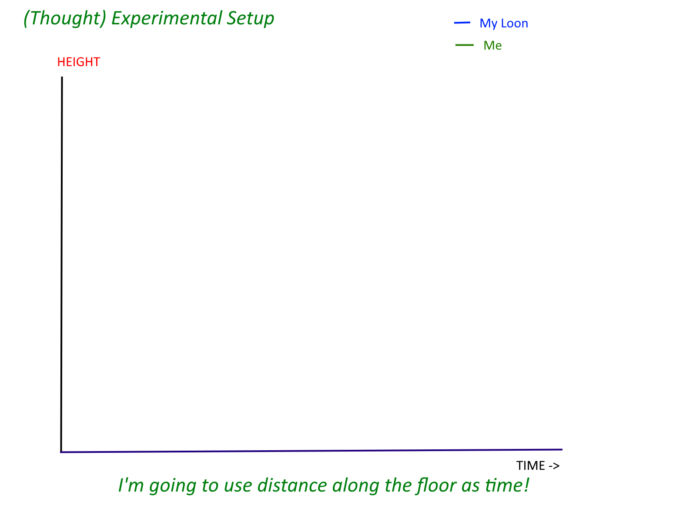
Heathcliff & I Measure Spacetime Curvature

Slide 22
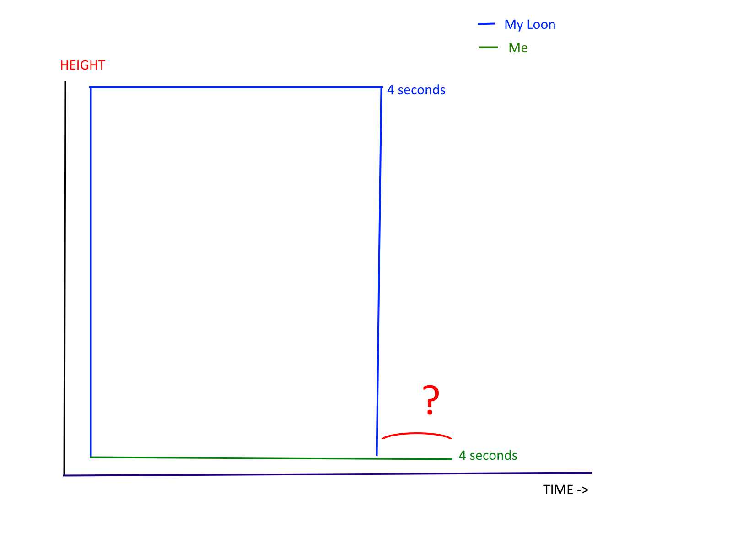
Heathcliff & I Measure Spacetime Curvature

Slide 23
Where have we seen that before?
This result demonstrates that our spacetime is curved. The degree of curvature determines the
strength of gravity.

Slide 24
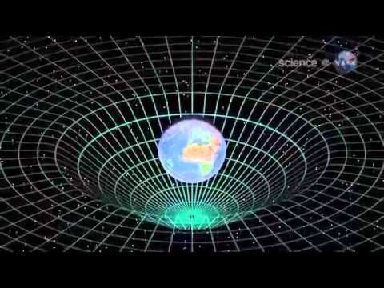
In brief, mass curves spacetime, which gives rise to gravity:

Slide 25
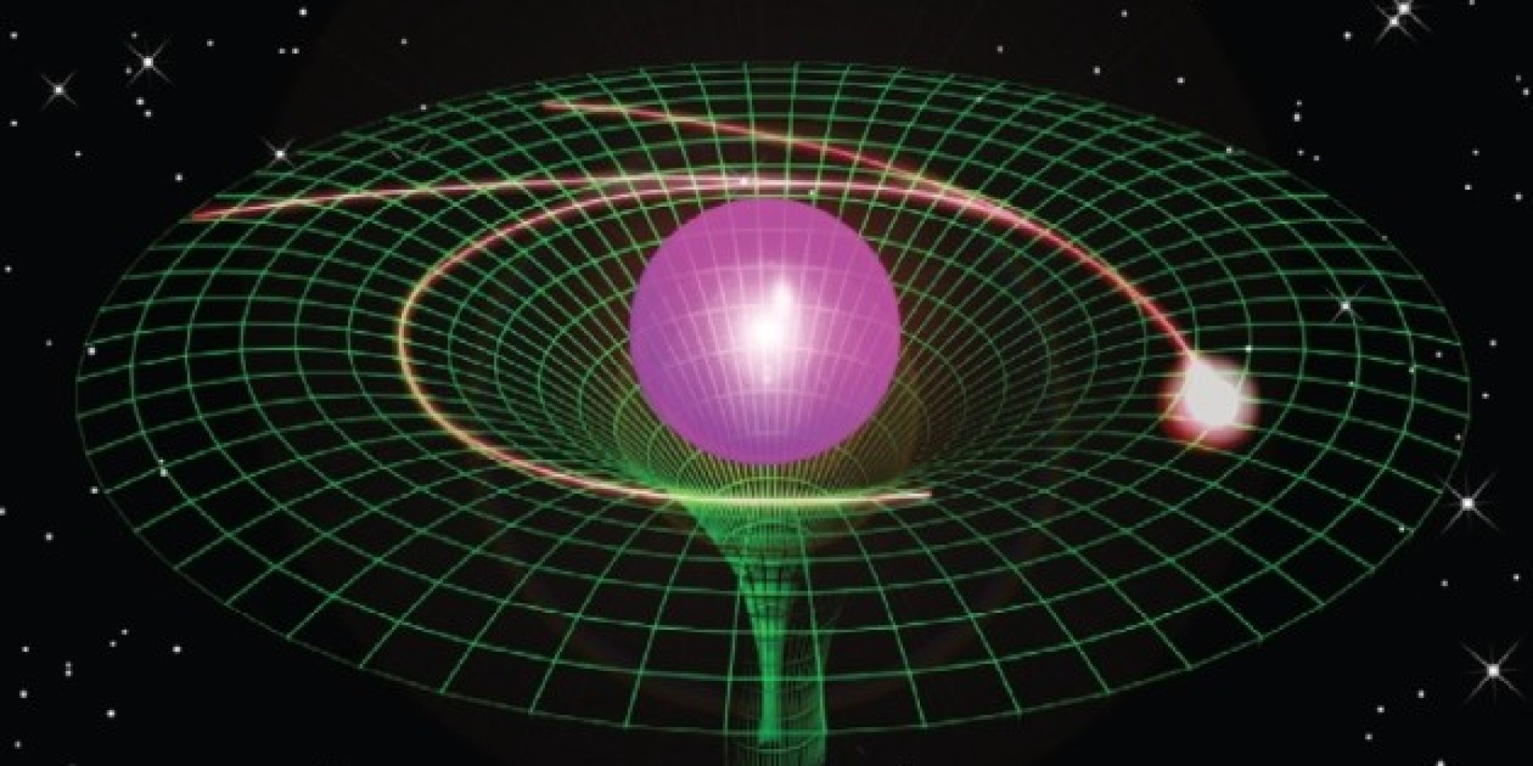
Curved spacetime tells things how to move - they follow geodesics, using local information
without needing a ‘magical force’ from the central mass to know where to go.
Mass tells spacetime how to curve, and curved spacetime tells things (via gravity) how to move.
HC:FB

Slide 26
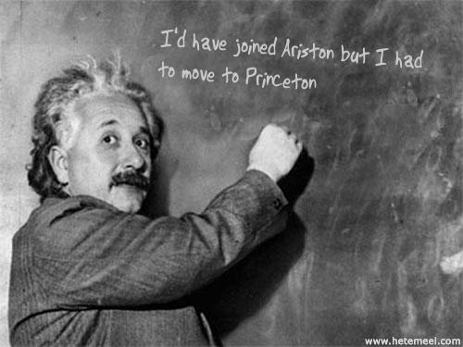
This is the part-time Watch Hill resident who had the
“happy thought” that led to all of this:

Slide 27
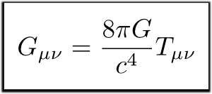
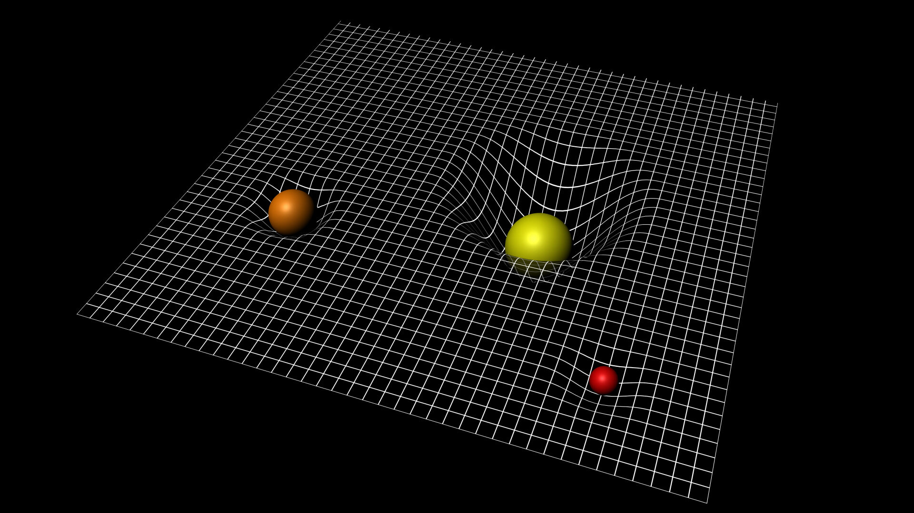
This all is known as Einstein’s General Theory of Relativity
G is geometry, T is how things move:
(Those G, T matrices (tensors) each have many components – it’s effectively 16 differential equations)
Solving this mathematically can be very hard, because as objects move, spacetime itself changes.
NH; Zoom;4d, etc.

Slide 28
We’re Done.
3. That funniness means curvature
1. Principle of Equivalence
4. That curvature is what gravity is.
2. Clocks act funny in gravity
Perhaps strangest – but
experimentally proven.
BR

